Slide 1

WPF Controls
Buttons, Boxes, Grids, Dialogs
SoftUni Team
Technical Trainers
Software University
http://softuni.bg

Slide 2
Table of Contents
Buttons
Button, ToggleButton, RadioButton
Boxes
TextBox, RichTextBox, GroupBox
Dialogs
SaveFile, OpenFile, Message
Bars
ProgressBar, ScrollViewer, ToolTip

Slide 3

XAML Controls

Slide 4
XAML Control
XAML Controls are all about behavior
They defer to templates to provide their visuals
Controls may use commands to represent supported operations
Controls raise events when something important happens
XAML provides a range of built-in controls
Most of these correspond to standard Windows control types

Slide 5

Buttons

Slide 6
Button
Buttons are controls that a user can click
An XML attribute specifies the handler for the Click event
Buttons derive from the common ButtonBase base class
<Button Click="ButtonClicked">Click</Button>
void ButtonClicked(object sender, RoutedEventArgs e)
{
MessageBox.Show("Button was clicked");
}

Slide 7

ToggleButton
Holds its state when it is clicked
IsChecked property
IsThreeState property
Checked for true
Unchecked for false
Indeterminate for null

Slide 8
ToggleButton - Example
<ToggleButton Content="Toggle"
Checked="HandleCheck" Unchecked="HandleUnchecked"
Height="100" Width="100" />
private void HandleCheck(object sender, RoutedEventArgs e) {
MessageBox.Show("Button was checked");
}
private void HandleUnchecked(object sender, RoutedEventArgs e) {
MessageBox.Show("Button was unhecked");
}

Slide 9
RadioButton and CheckButton
They derive from ButtonBase indirectly via the ToggleButton class
IsChecked property, indicating whether the user has checked the button
CheckBox is nothing more than a ToggleButton with a different appearance
Radio buttons are normally used in groups in which only one button may be selected at a time

Slide 10
RadioButton - Example
<StackPanel>
<RadioButton GroupName="Coupe">Hatchback</RadioButton>
<RadioButton GroupName="Coupe">Sedan</RadioButton>
<RadioButton GroupName="Coupe">Van</RadioButton>
<RadioButton GroupName="Coupe">Limousine</RadioButton>
<RadioButton GroupName="Fuel">Gasoline</RadioButton>
<RadioButton GroupName="Fuel">Diesel</RadioButton>
<RadioButton GroupName="Fuel">Electricity</RadioButton>
</StackPanel>

Slide 11

Boxes

Slide 12
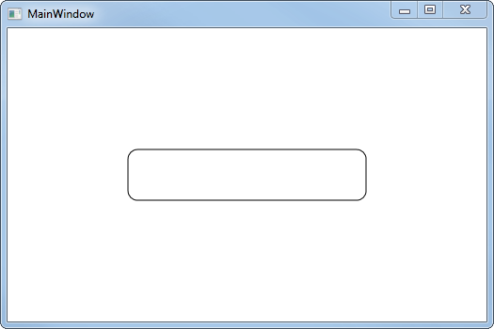
TextBox
It is the most basic text-input control found in WPF, allowing the end-user to write plain text
Single line
Dialog input
Multiple lines (like an editor)
By setting AcceptsReturn to true, it can edit multiple lines
<TextBox Text="Test" />
<TextBox AcceptsReturn="True"
VerticalScrollBarVisibility="Visible" Text="Test" />

Slide 13
RichTextBox
RichTextBox supports all of the commands defined by the EditingCommands class
Both TextBox and RichTextBox offer built-in spellchecking
SpellCheck.IsEnabled attached property
<RichTextBox>
<FlowDocument>
<Paragraph>Hello, world!</Paragraph>
<Paragraph>WPF Essentials</Paragraph>
</FlowDocument>
</RichTextBox>

Slide 14


PasswordBox
PasswordBox with default character - •
PasswordBox options
<PasswordBox />
<PasswordBox MaxLength="6" PasswordChar="X" />

Slide 15
GroupBox and Expander
Both provide a container for arbitrary content and a place for a header on top
Expander can be expanded and collapsed
GroupBox always shows its content
Both controls derive from HeaderedContentControl
We can place whatever content we like directly inside the control

Slide 16
GroupBox Example
<GroupBox Header="WPF Essentials">
<StackPanel>
<TextBlock>First name:</TextBlock>
<TextBox />
<TextBlock>Last name:</TextBlock>
<TextBox />
<Button Margin="0,20">Add User</Button>
</StackPanel>
</GroupBox>

Slide 17
Expander Example
<Expander Header="Click to show/hide content...">
<TextBlock TextWrapping="Wrap" FontSize="18">
WPF Essentials @ SoftUni
</TextBlock>
</Expander>
<Expander ExpandDirection="Right">
<TextBlock TextWrapping="Wrap" FontSize="18">
WPF Essentials @ SoftUni
</TextBlock>
</Expander>

Slide 18

Dialogs

Slide 19

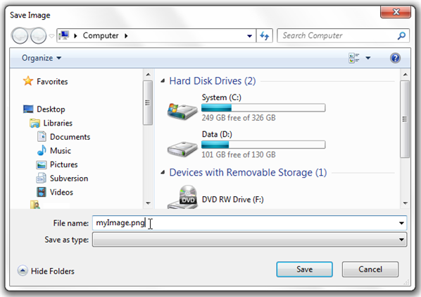
Dialogs
Shows specific information to users
Gather useful information from users
Part of Windows API
Dialogs are standard for opening and saving files in the Microsoft.Win32 namespace

Slide 20
SaveFileDialog
<Button Name="btnSaveFile" Click="SaveFile_Click">Save file</Button>
<TextBox Name="txtEditor" AcceptsReturn="True" />
private void SaveFile_Click(object sender, RoutedEventArgs e)
{
SaveFileDialog saveFileDialog = new SaveFileDialog();
if(saveFileDialog.ShowDialog() == true) {
File.WriteAllText(saveFileDialog.FileName, txtEditor.Text);
}
}

Slide 21
OpenFileDialog
<Button Name="btnOpenFile" Click="OpenFile_Click">Open file</Button>
<TextBox Name="txtEditor" />
private void OpenFile_Click(object sender, RoutedEventArgs e)
{
OpenFileDialog openFileDialog = new OpenFileDialog();
if(openFileDialog.ShowDialog() == true) {
txtEditor.Text = File.ReadAllText(openFileDialog.FileName);
}
}

Slide 22
MessageBox
MessageBox with a Title
MessageBox with Buttons
MessageBox with Icon
MessageBox.Show("Hello, world!", "SoftUni");
MessageBox.Show("Hello, world!",
"SoftUni",
MessageBoxButton.YesNoCancel);
MessageBox.Show("Hello, world!", "SoftUni",
MessageBoxButton.OK,
MessageBoxImage.Information);

Slide 23

Bars

Slide 24

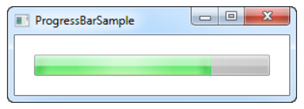
ProgressBar
It is used to give a visual indication on how far in the process you currently are
<ProgressBar Minimum="0" Maximum="100" Value="75" />

Slide 25
ProgressBar - Example
<ProgressBar Name="MyProgressBar" Width="30" Height="30"></ProgressBar>
<Button Click="Start">Start</Button>
private void Start(object sender, RoutedEventArgs e) {
for (int i = 0; i < 100; i++) {
MyProgressBar.Dispatcher .Invoke(() => MyProgressBar.Value += 10, DispatcherPriority.Background);
Thread.Sleep(500);
}
}

Slide 26
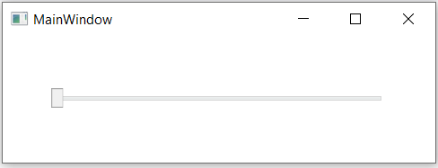
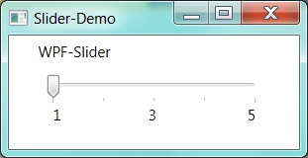
Sliders
It's allows a user to select a range of values by moving a Thumb control along a track.
<Slider Maximum="100" TickFrequency="5" />

Slide 27
ProgressBar - Example
<Slider Name="Slider" Minimum="0" Maximum="100" TickFrequency="2" ValueChanged="ValueChanged" />
<TextBlock Name="Text" Text="Current value: 0" />
void ValueChanged(object sender, RoutedPropertyChangedEventArgs<double> e)
{
int value = Convert.ToInt32(e.NewValue);
string message = $"Current value: {value}";
this.Text.Text = message;
}

Slide 28
ScrollView
It provides a scrollable area that can contain other visible elements
<ScrollViewer Height="200" Width="200" HorizontalScrollBarVisibility="Auto" VerticalScrollBarVisibility="Auto">
<TextBlock Width="300" TextWrapping="Wrap"
Text="Clean code is not written by following a set of rules. You don’t become a software craftsman by learning a list of heuristics. Professionalism and craftsmanship come from values that drive disciplines./>
</ScrollViewer>

Slide 29
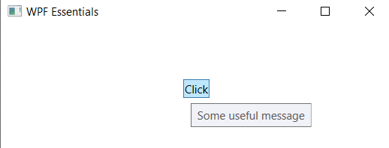
ToolTips
Extra information about a specific control or link by hovering the mouse over it.
<Button ToolTip="Some usefull message">Click</Button>

Slide 30

Menus

Slide 31
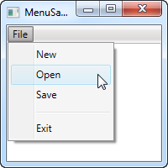
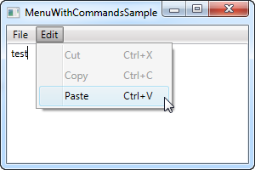
Menu
It is a control that enables you to hierarchically organize elements associated with commands and event handlers

Slide 32
MenuItem
It is a headered items control
The Header is actually the main object
MenuItem contains many properties for customizing
Icon
IsCheckable
InputGestureText
Can handle events or assign a command to MenuItem's Command property

Slide 33
Menu Example
<Menu>
<MenuItem Header="File">
<MenuItem Header="New" />
<MenuItem Header="Open" />
<MenuItem Header="Save" />
<Separator />
<MenuItem Header="Exit" />
</MenuItem>
</Menu>

Slide 34
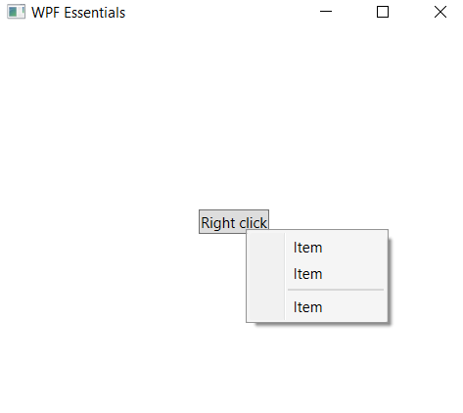
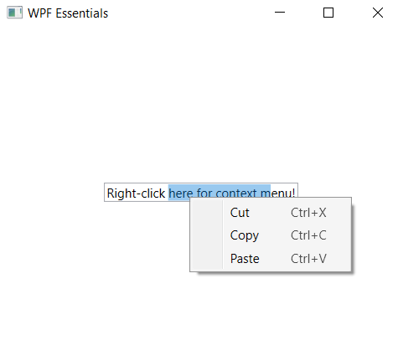
ContextMenu
It is often referred to as a popup or pop-up menu
Shown upon certain user actions, usually a right-click

Slide 35
ContextMenu - Example
<TextBox Text="Right-click here for context menu!">
<TextBox.ContextMenu>
<ContextMenu>
<MenuItem Command="Cut"/>
<MenuItem Command="Copy"/>
<MenuItem Command="Paste" />
</ContextMenu>
</TextBox.ContextMenu>
</TextBox>

Slide 36
ContextMenu – Example (2)
<Button Content="Right click">
<Button.ContextMenu>
<ContextMenu>
<MenuItem Header="Item" />
<MenuItem Header="Item" />
<Separator />
<MenuItem Header="Item" />
</ContextMenu>
</Button.ContextMenu>
</Button>

Slide 37

Summary
Buttons
Button, ToggleButton, RadioButton
Boxes
TextBox, RichTextBox, GroupBox
Dialogs
SaveFile, OpenFile, Message
Bars
ProgressBar, ScrollViewer, ToolTip
…
…
…

Slide 38
https://softuni.bg/trainings/courses

Slide 39












SoftUni Diamond Partners
Notes:
39

Slide 40




SoftUni Organizational Partners
Notes:
40

Slide 41




Trainings @ Software University (SoftUni)
Software University – High-Quality Education and Employment Opportunities
softuni.bg
Software University Foundation
http://softuni.foundation/
Software University @ Facebook
facebook.com/SoftwareUniversity
Software University Forums
forum.softuni.bg

Slide 42

License
This course (slides, examples, demos, exercises, homework, documents, videos and other assets) is copyrighted content
Unauthorized copy, reproduction or use is illegal
© SoftUni – https://softuni.org
© Software University – https://softuni.bg
Notes:
42

